Slide 1
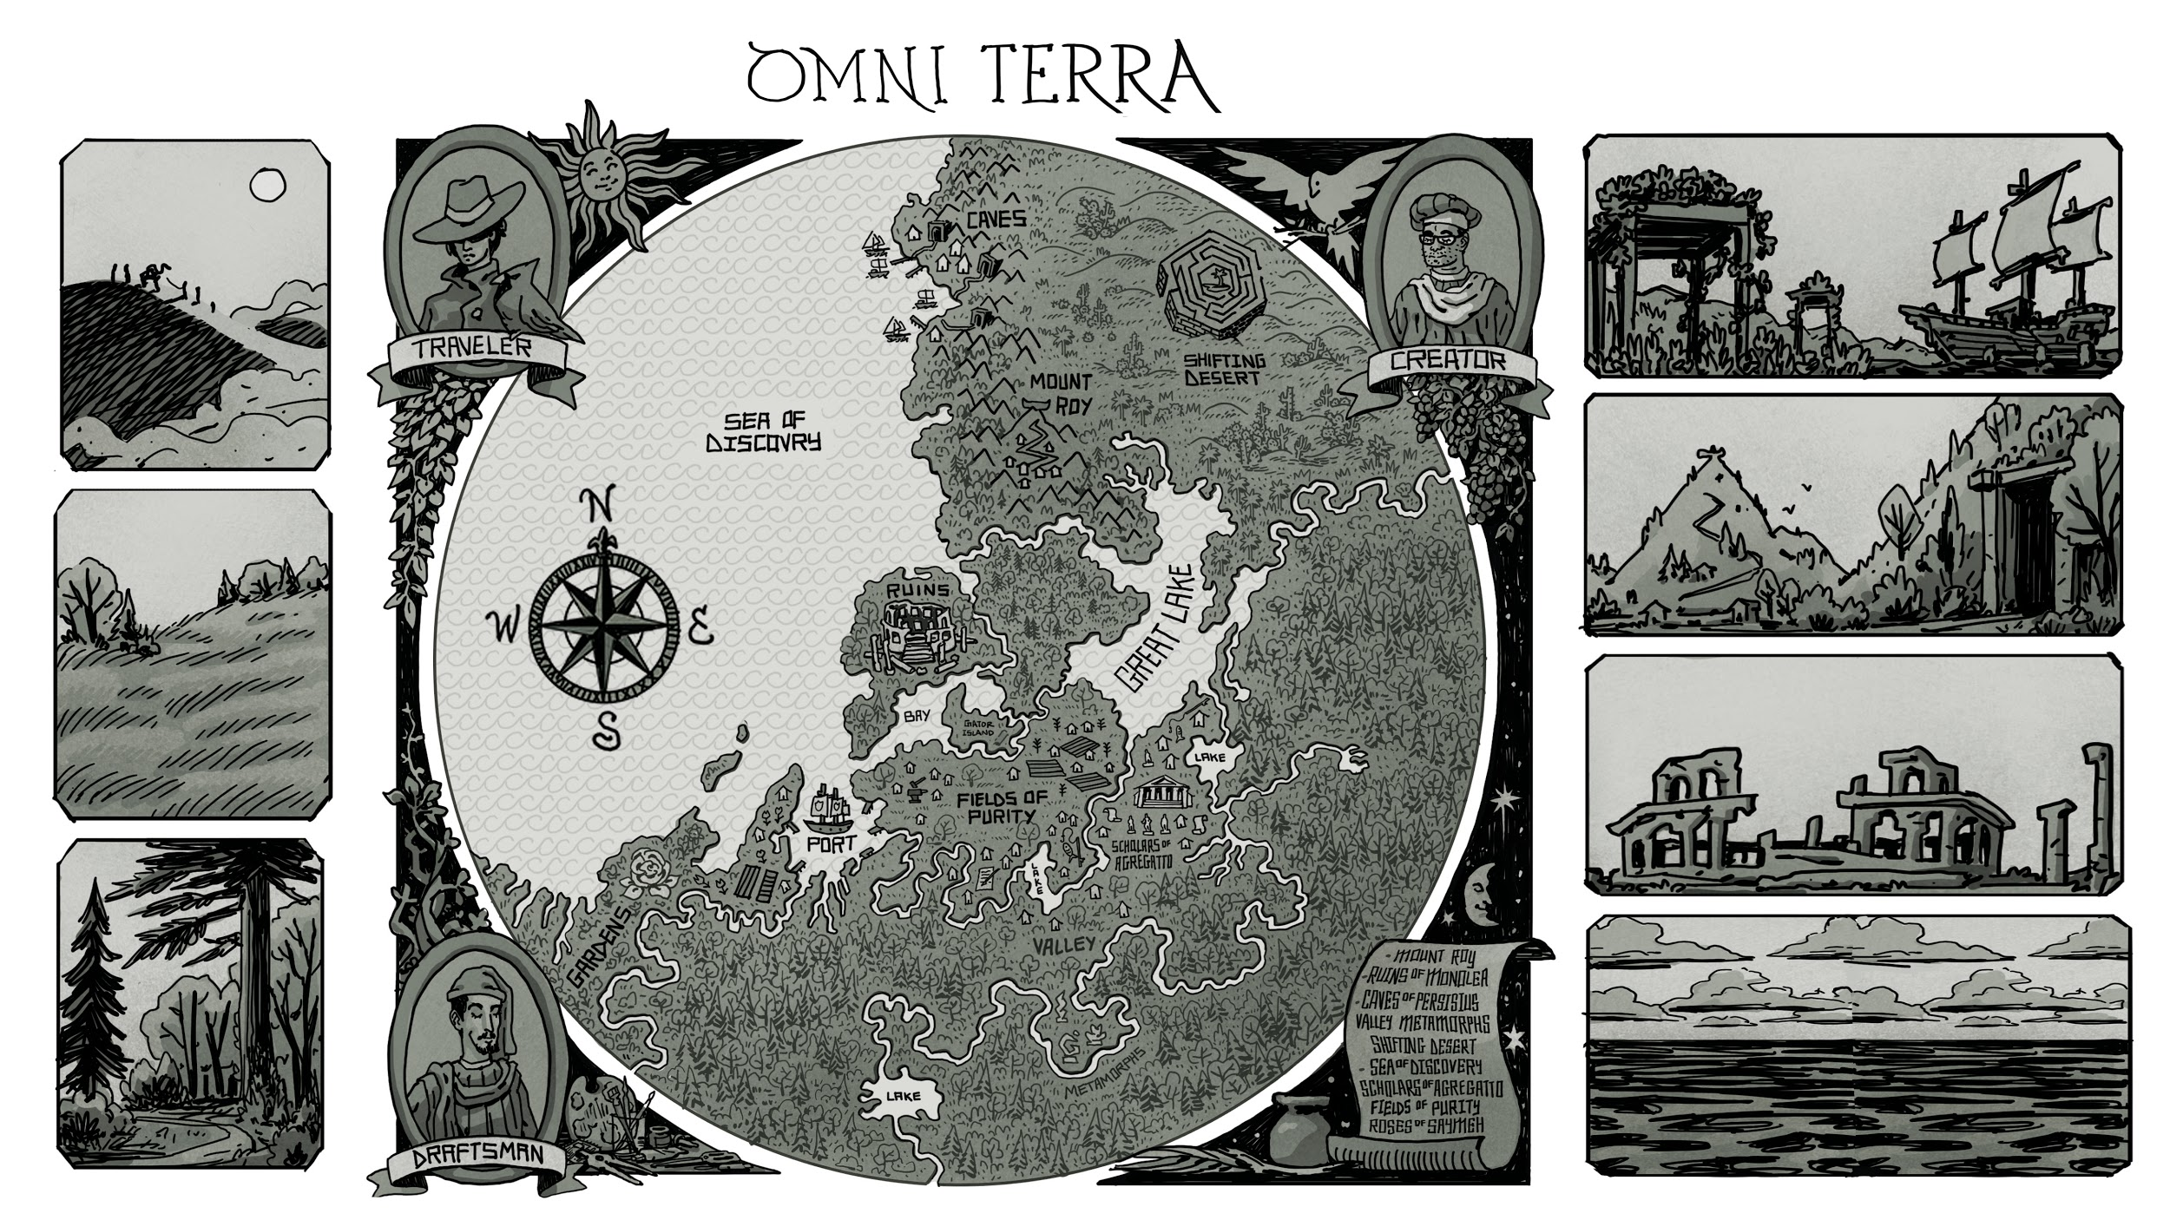
Discovering RESTful Web Microservices
Mike Amundsen @mamund API Academy

Slide 2
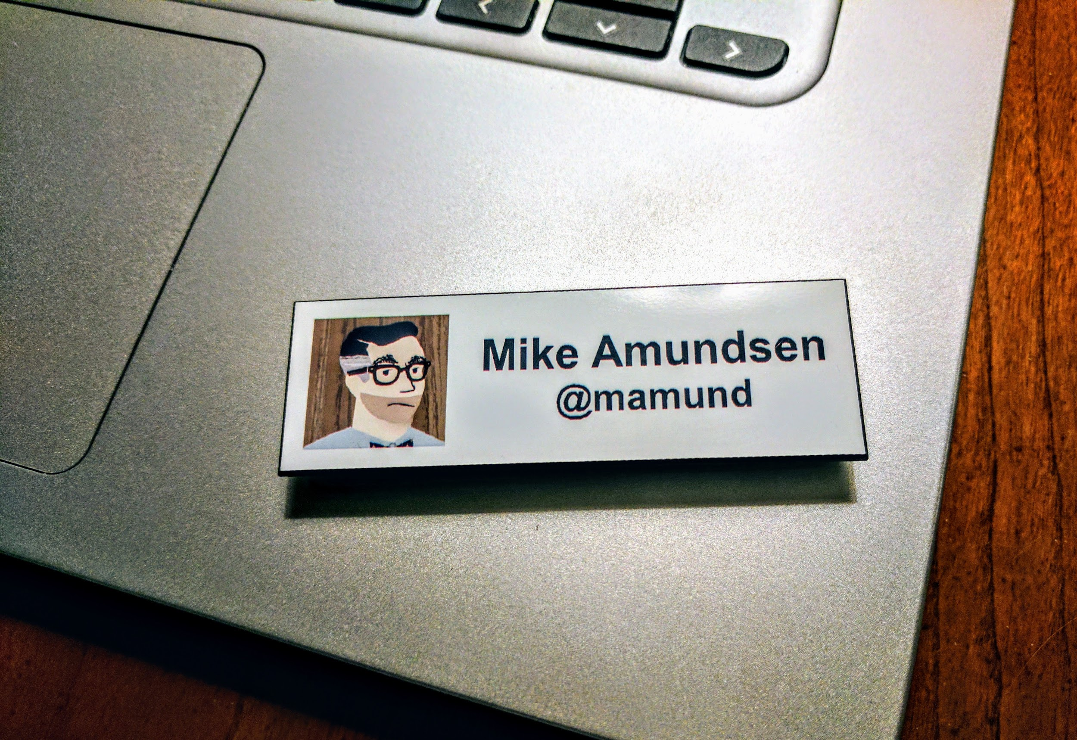

Slide 3
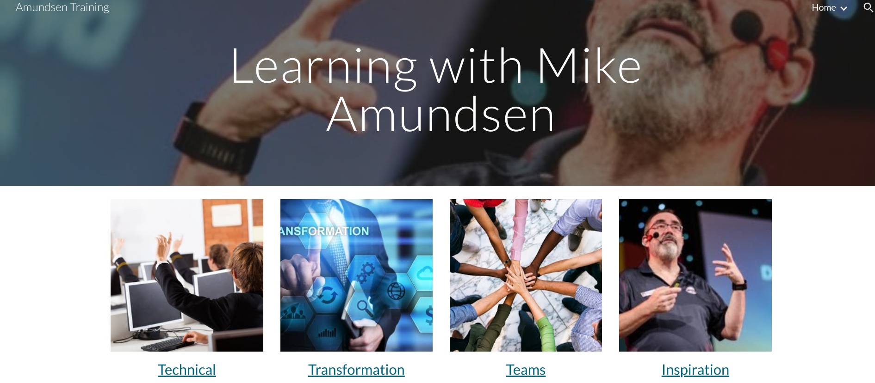
training.amundsen.com

Slide 4
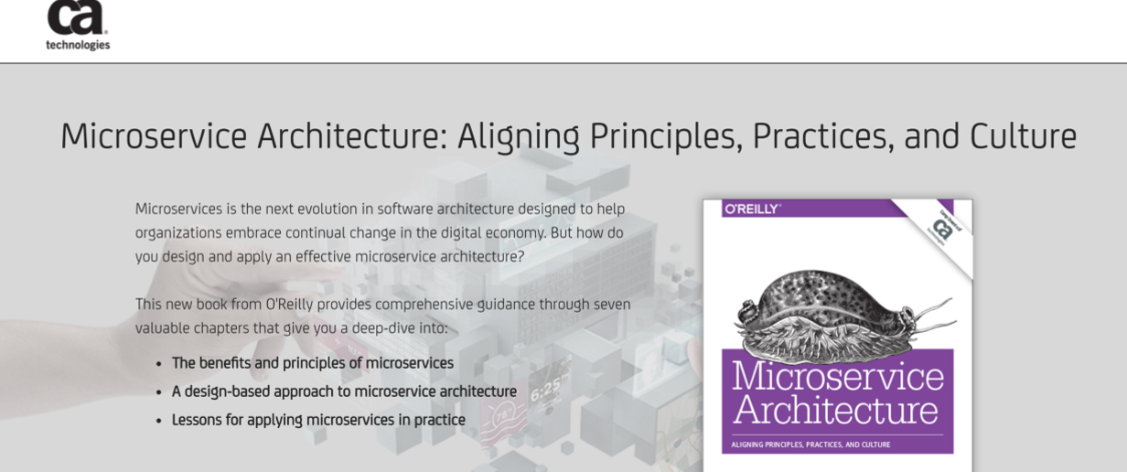
http://g.mamund.com/msabook

Slide 5
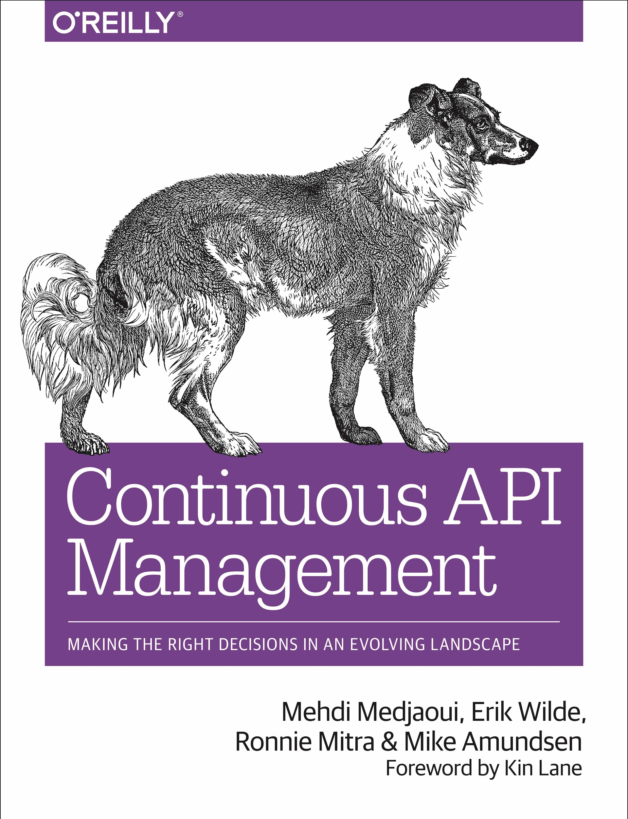
http://g.mamund.com/cambook
"A reusable guide to the technology, business, and politics of doing APIs at scale within the enterprise." -- Kin Lane, API Evangelist

Slide 6
Discovering

Slide 7
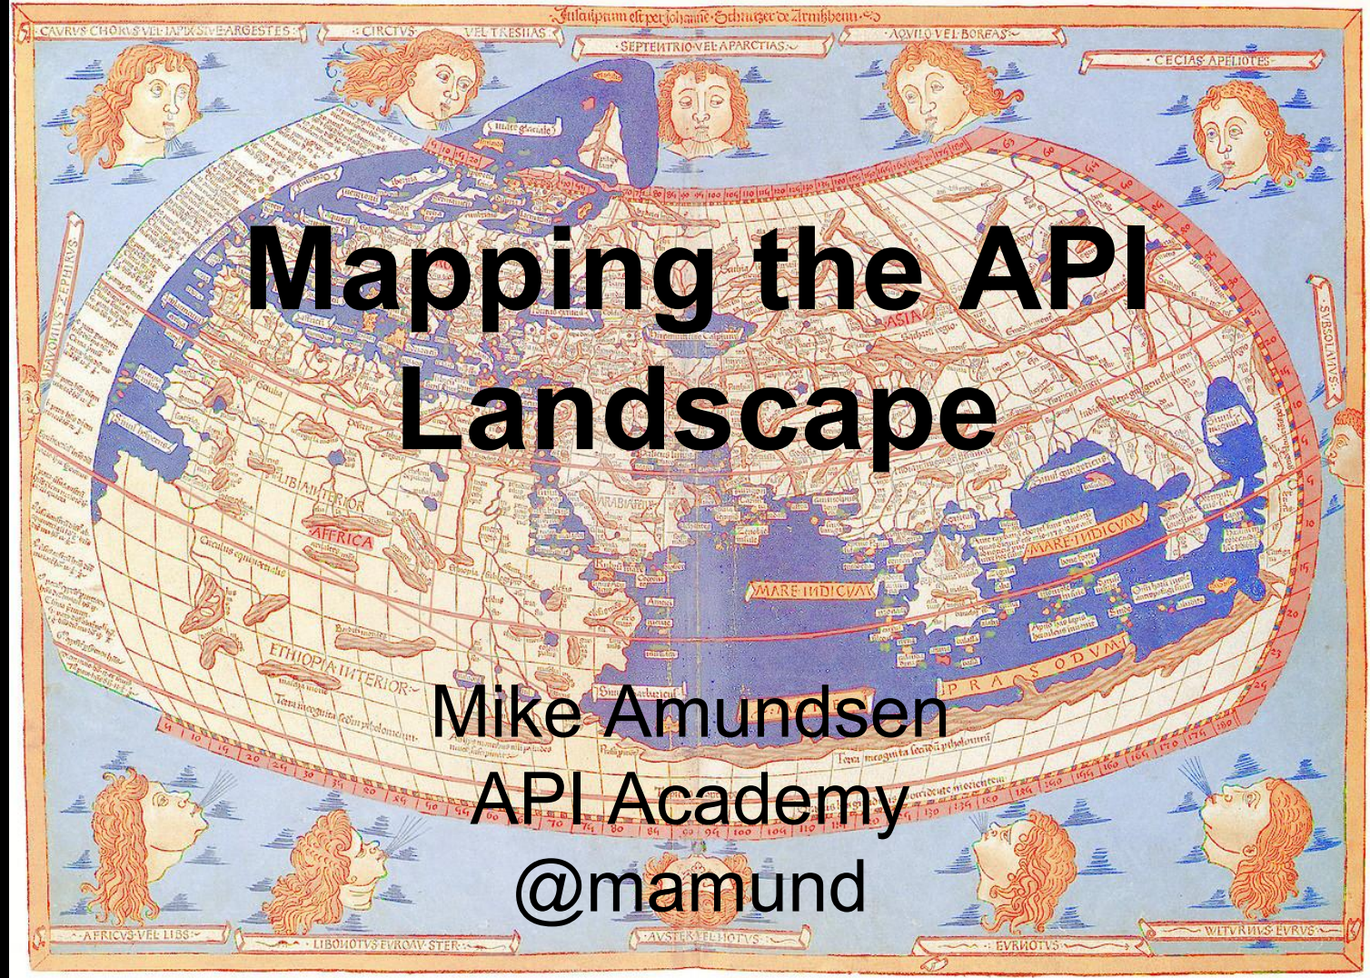
A few years ago, in a slide deck far away...

Slide 8
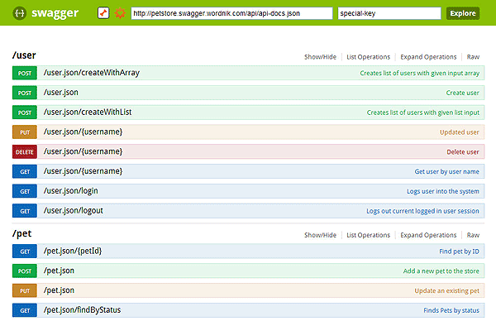

Slide 9
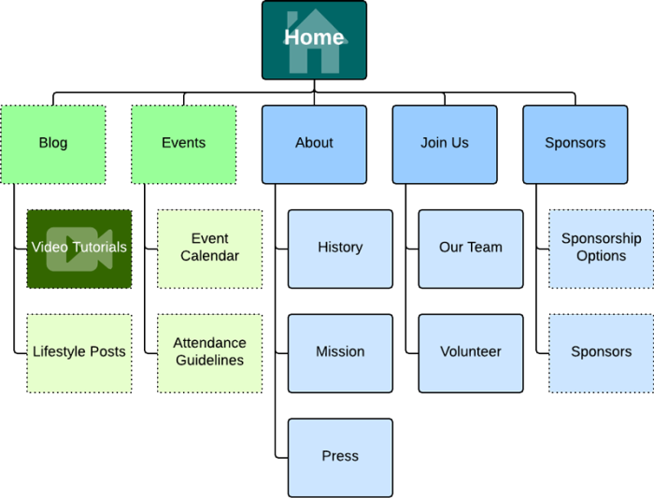

Slide 10
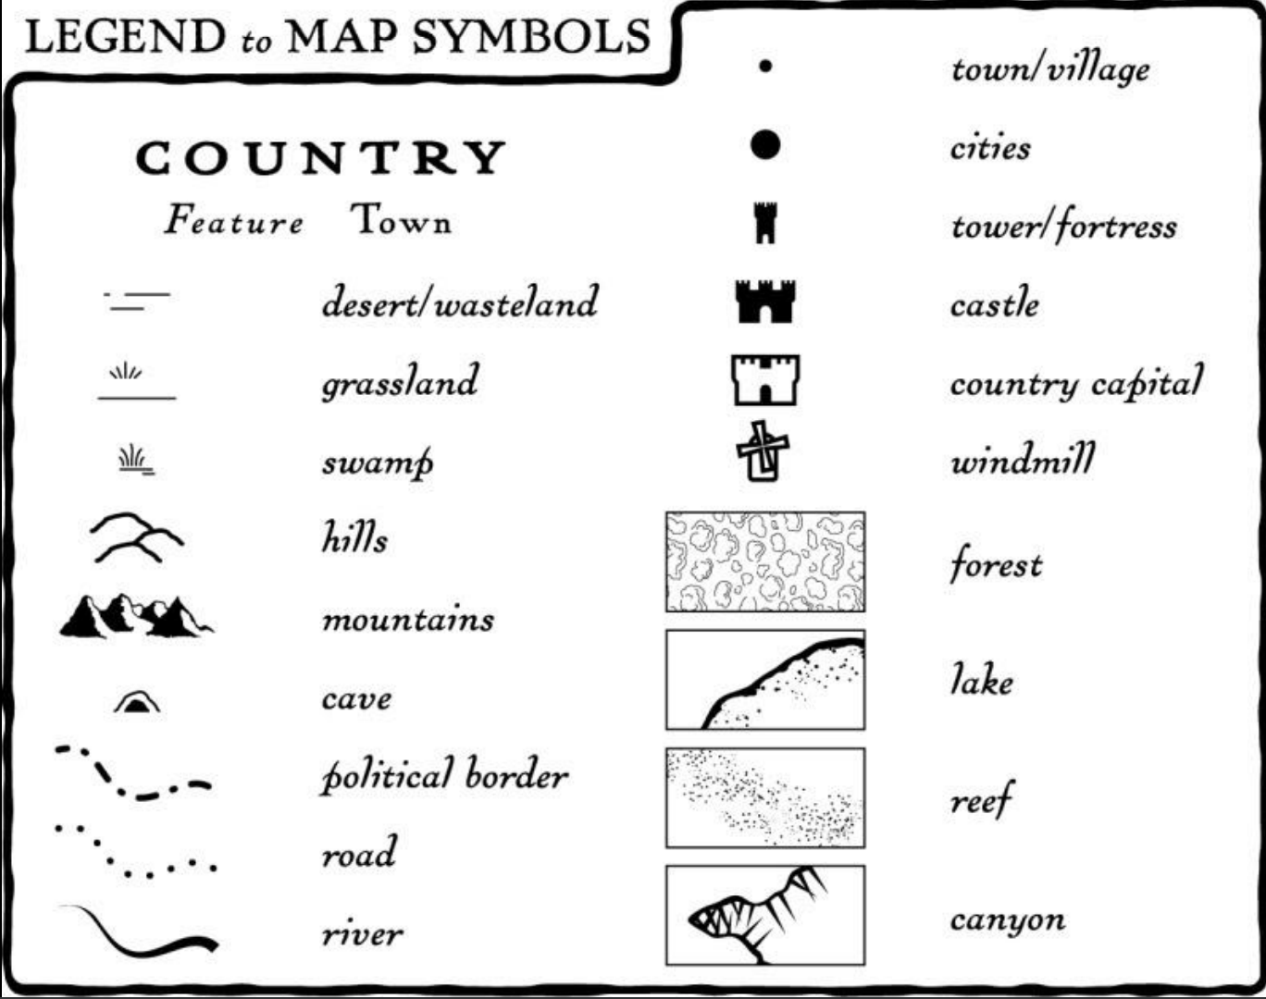

Slide 11
RESTful Web Microservices?

Slide 12
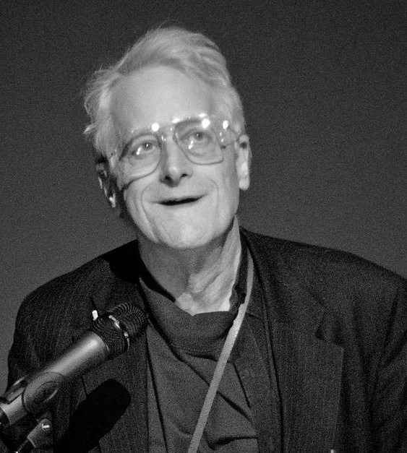
The Web
The words hypertext, hyperlink, and hypermedia were coined by Ted Nelson around 1965.
Ted Nelson
By Dgies - Own work, CC BY-SA 3.0, https://commons.wikimedia.org/w/index.php?curid=13691666

Slide 13
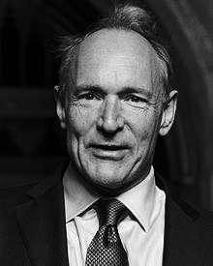
HTTP and HTML
"We should work toward a universal linked information system, in which generality and portability are [most] important." -- Tim Berners-Lee, 1989

Slide 14

REpresentational State Transfer (REST)
"REST emphasizes scalability of component interactions, generality of interfaces,
independent deployment of components, and intermediary components." -- Roy Fielding, 2000

Slide 15

Microservices
"An approach to developing a single application as a suite of small services, each running in its own process and communicating with lightweight mechanisms." -- Martin Fowler, 2014
https://www.thoughtworks.com/insights/blog/microservices-nutshell

Slide 16
Microservice Characteristics
Make each program do one thing well
Expect the output of every program to be the input of another program
Design and build software to be tried early
Use tools to lighten the programming task

Slide 17
Unix Operating Principles (1978)
Make each program do one thing well
Expect the output of every program to be the input of another program
Design and build software to be tried early
Use tools to lighten the programming task
https://en.wikipedia.org/wiki/Unix_philosophy

Slide 18
Loosely-coupled components running in an engineered system.

Slide 19
Traveling

Slide 20
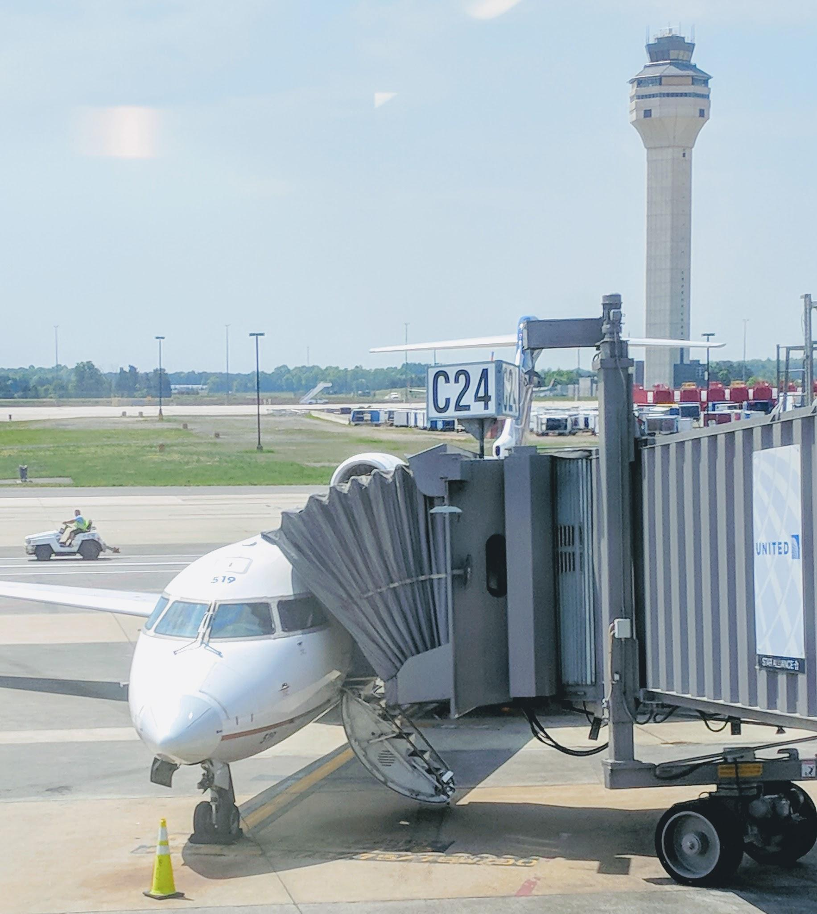
Traveling

Slide 21

Traveling the Network

Slide 22

Programming the Network

Slide 23
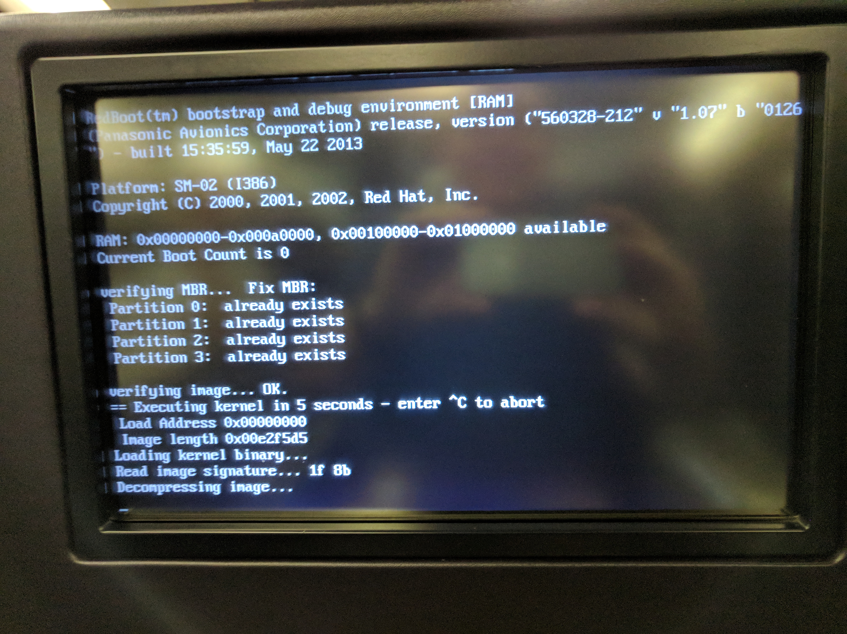

Slide 24
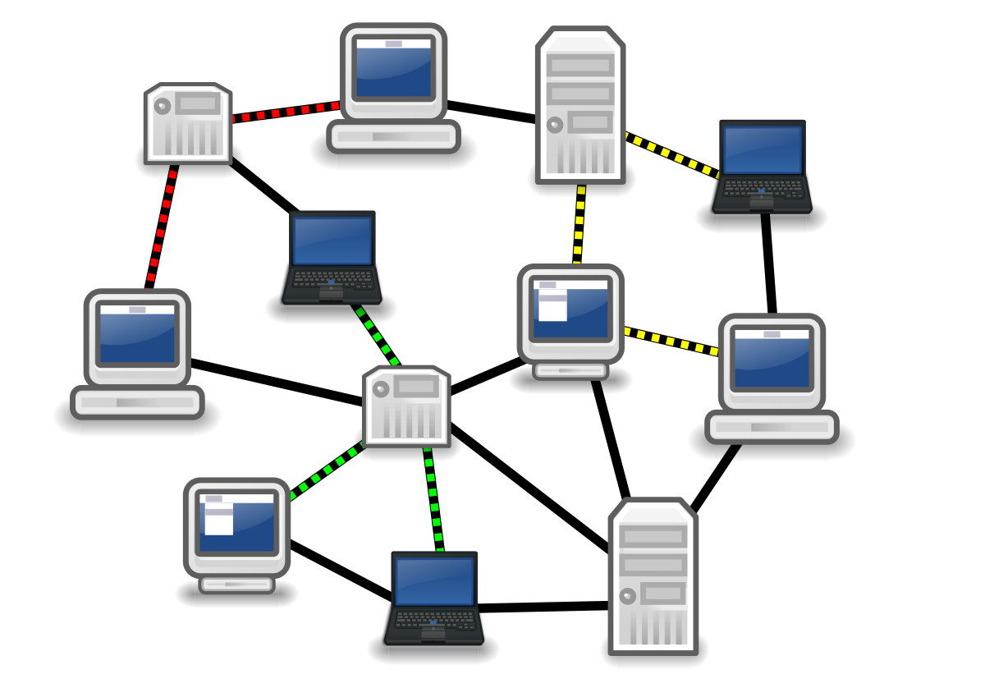

Slide 25
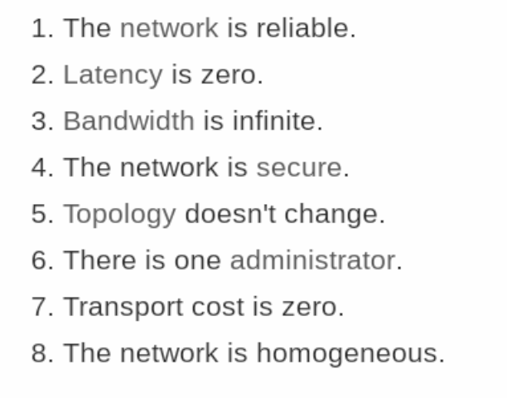
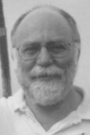
Fallacies of Distributed Computing (1994)
L Peter Deutsch
https://en.wikipedia.org/wiki/Fallacies_of_distributed_computing

Slide 26

Programming the Network
"There is no simultaneity at a distance." -- Pat Helland (2005)
Pat Helland
"Data on the Inside vs. Data on the Outside, Helland (2005) http://cidrdb.org/cidr2005/papers/P12.pdf

Slide 27

“Bugs will happen. They cannot be eliminated, so they must be survived instead.” -- Michael T. Nygard

Slide 28
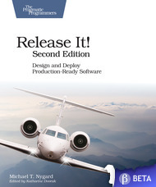

Slide 29
Nygard Stability Patterns
Timeout
Circuit Breaker
Bulkhead
Steady State
Fail Fast
Handshaking

Slide 32
"The journey of a thousand miles begins with one step." -- Lao Tzu

Slide 33
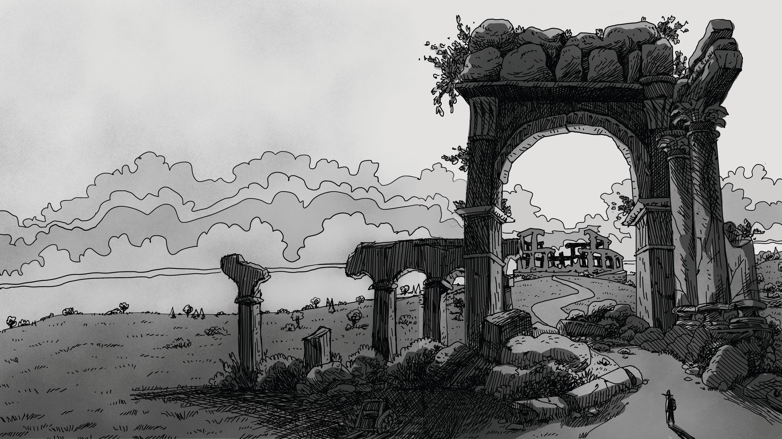

Slide 34
Let's talk about code for a bit...

Slide 35
Let's talk about code for a bit...

Slide 36


Slide 37
Stateless Microservices
Simple processors (converters, translators, etc.)
No dependence on other microservices
No local data storage (disk I/O)
The most common MSC example, but the least useful!

Slide 38
Stateless Microservices
No shared state
Easy to replace
Easy to scale up

Slide 39
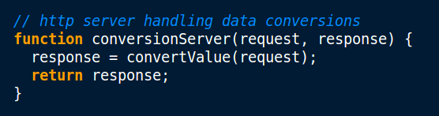
Stateless Microservices

Slide 40
But, what about the network?

Slide 41
Programming the network
What if the work takes too long?

Slide 42
Stateless Microservices
Fail-Fast

Slide 43
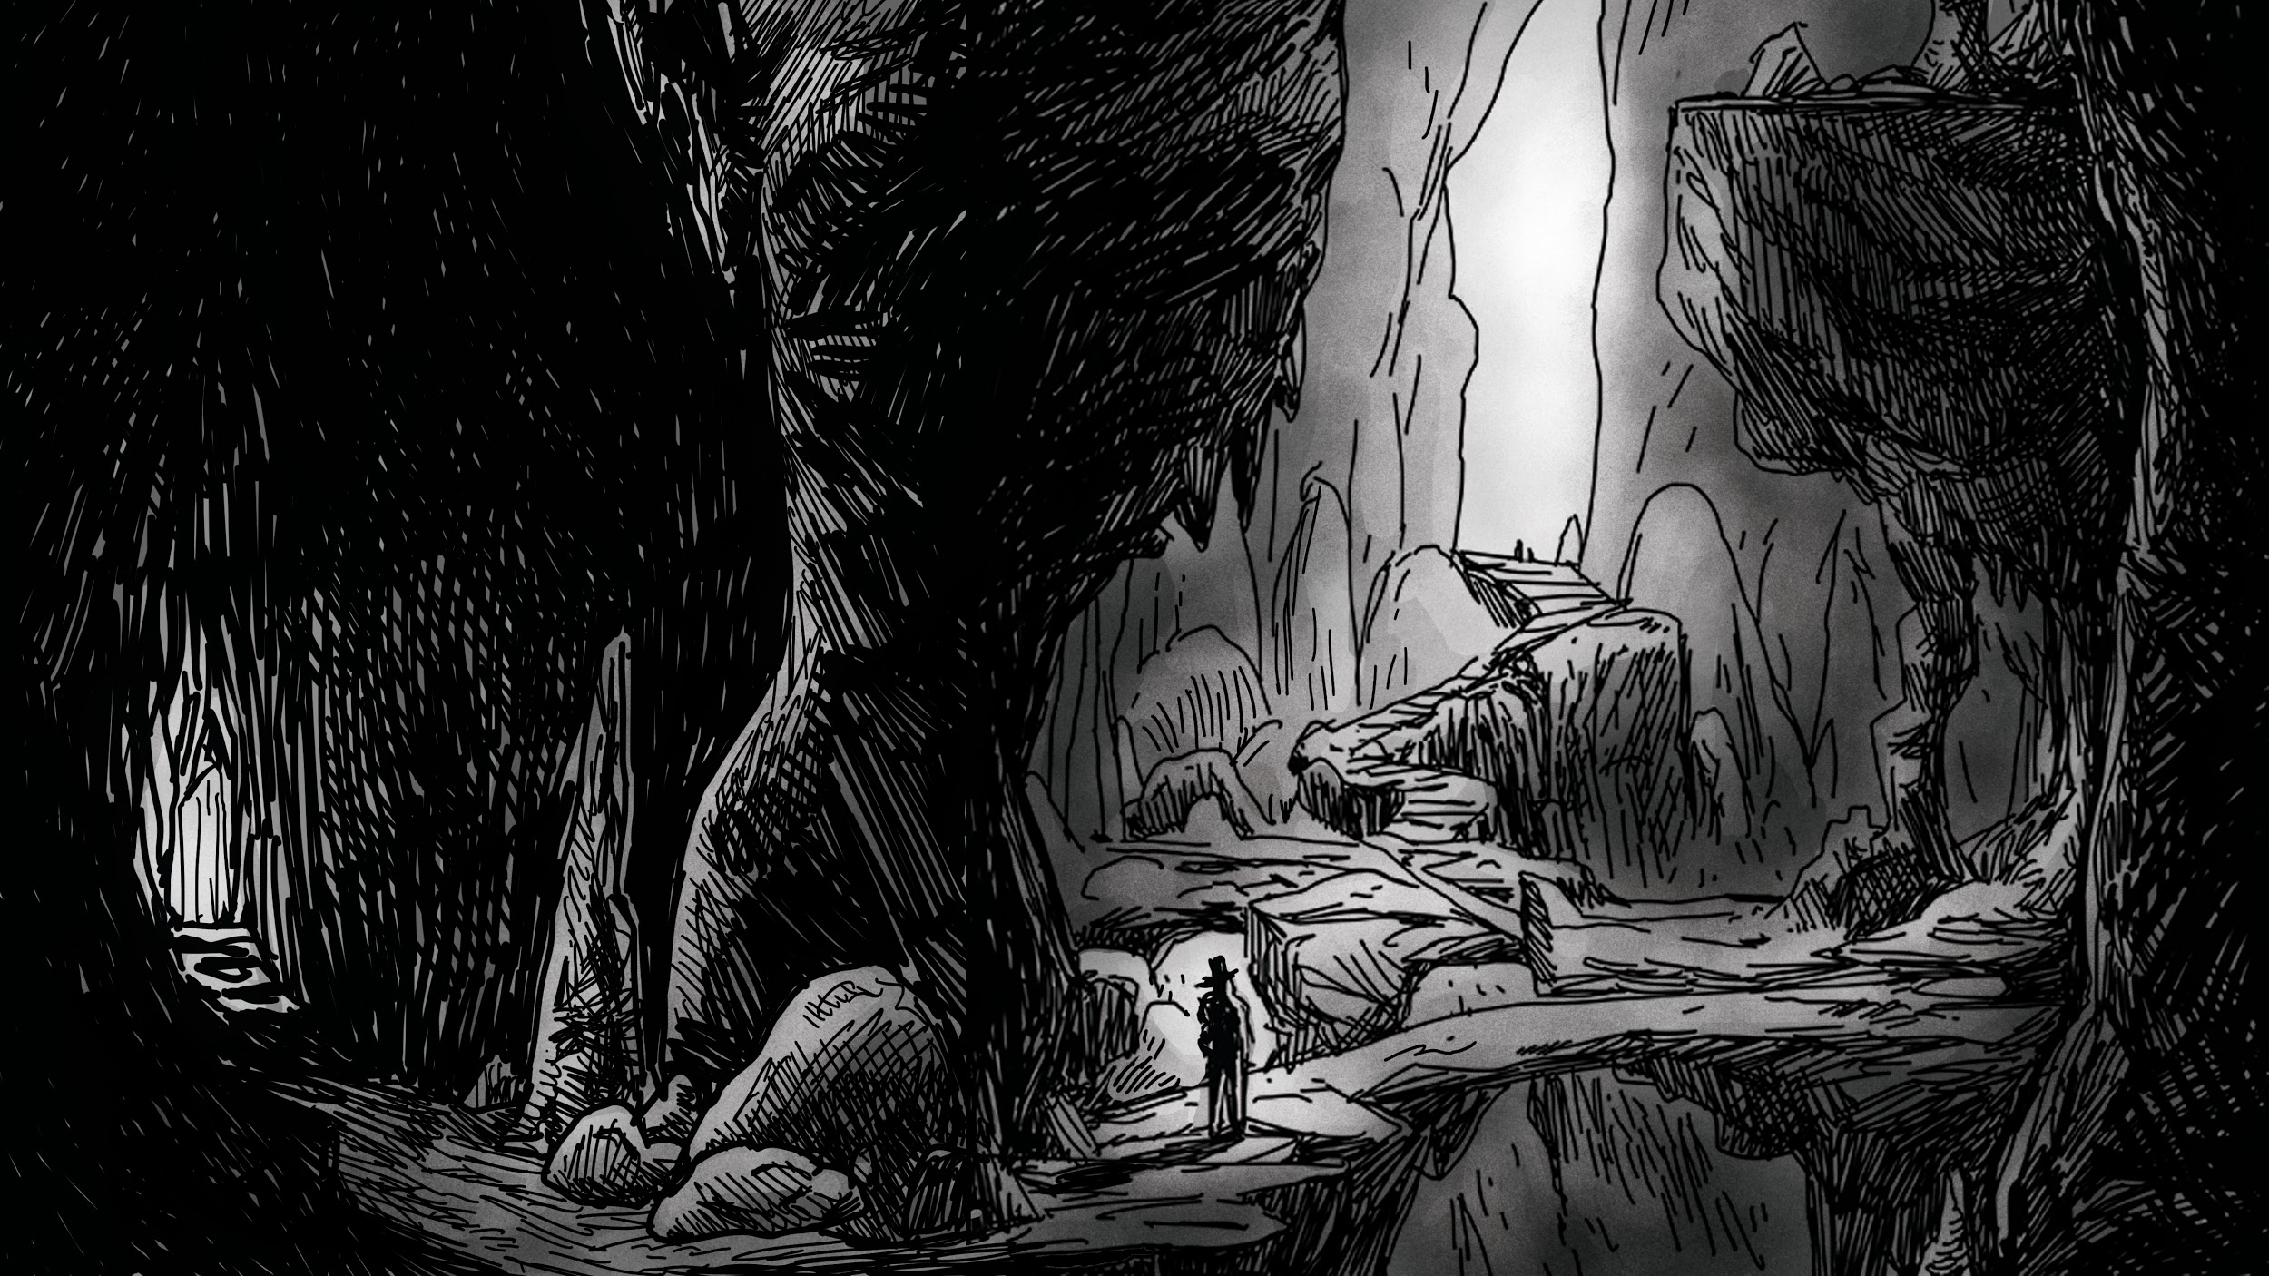
Caves of Persisius

Slide 44
Persistence Microservices
Simple (local) storage (reads and/or writes)
Disk I/O dependent
Possibly VM or one-U dependent
Commonly needed MSC, not the easiest to implement.

Slide 45
Persistence Microservices
System of Record/Source of Truth
Relatively easy to scale for reads (CQRS)
No cross-service two-phase commits (Saga)

Slide 46
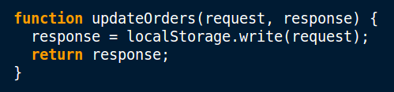
Persistence Microservices

Slide 47
But, what about the network?

Slide 48
Programming the network
What if the work takes too long?
What is the dependent service doesn't respond in time?
What if the dependent service is down?
What if the storage overflows (data, logs, etc.)?

Slide 49
Persistence Microservices
Fail-Fast
Timeout
Circuit Breaker
Steady State

Slide 50
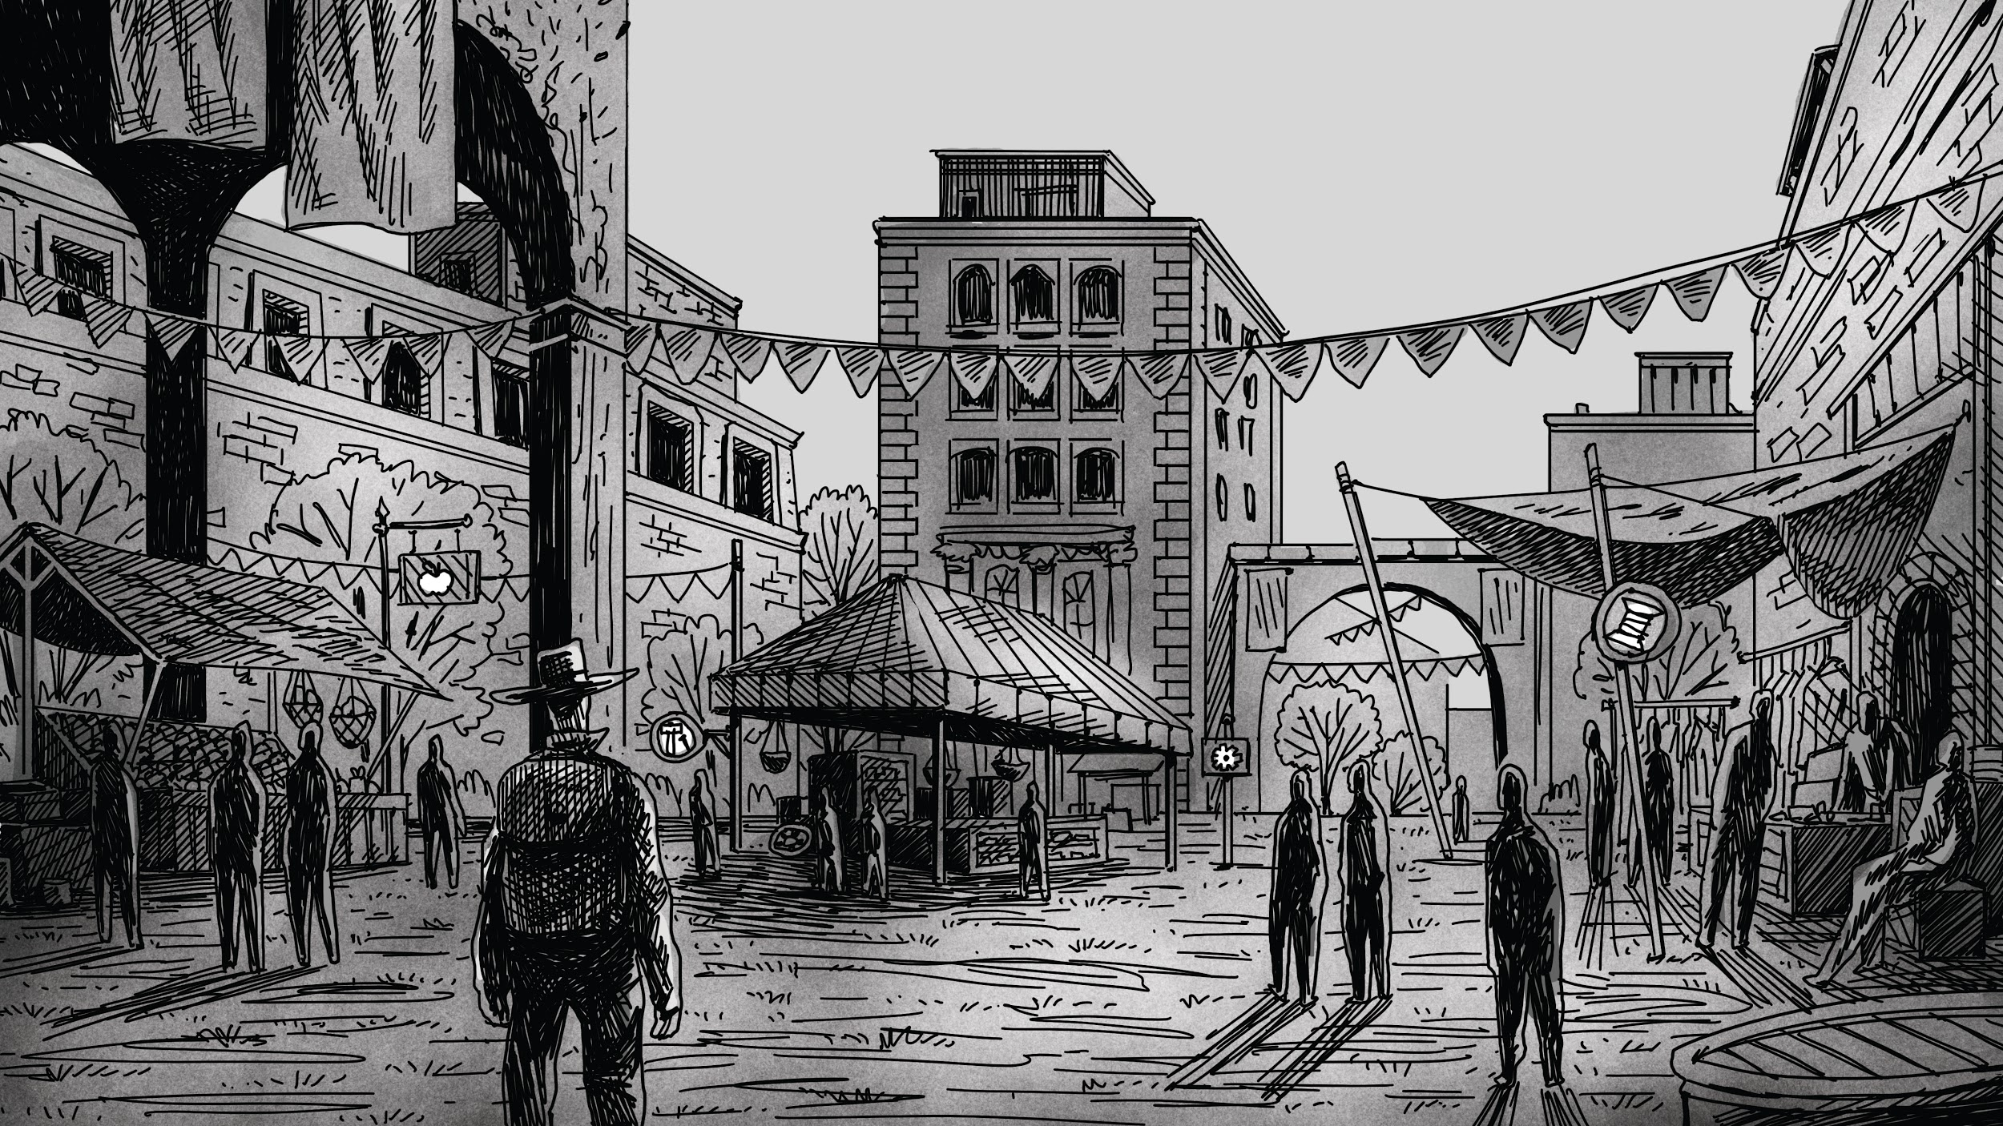
Scholars of Aggregato

Slide 51
Aggregator Microservices
Depends on other ("distant") microservices
Network dependent
Usually Disk I/O dependence, too
The most often-needed; most challenging, too.

Slide 52
Aggregator Microservices
Sequence vs. Parallel calls
Timing is everything
Easy to scale (should be…)

Slide 53
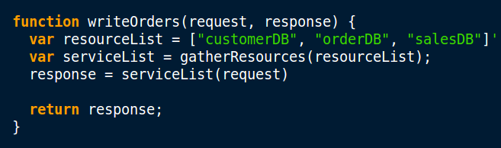
Aggregator Microservices

Slide 54
But, what about the network?

Slide 55
Programming the network
What if the work takes too long?
What if a dependent services doesn't respond in time?
What if a dependent service is down?
What if storage overflows (data, logs, etc.)?
What if a dependent service is unhealthy?
What if traffic for a service spikes?

Slide 56
Aggregator Microservices
Fail-Fast
Timeout
Circuit Breaker
Steady State
Handshaking
Bulkhead

Slide 57
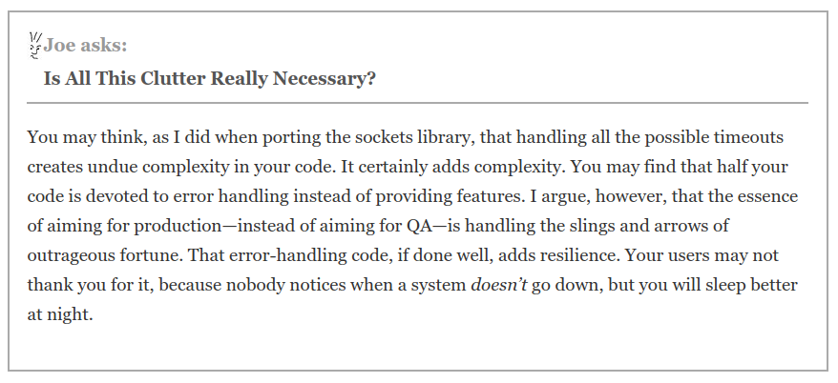
Nygard's Admonition...

Slide 58


Slide 59
Let not talk about code for a bit...

Slide 60


Slide 61
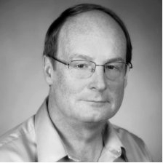
Aim for Interop, not Integration...
"Interoperation is peer to peer. Integration is where a system is subsumed within another." -- Michael Platt, Microsoft
https://blogs.technet.microsoft.com/michael_platt/2005/08/30/integration-and-interoperability/

Slide 62
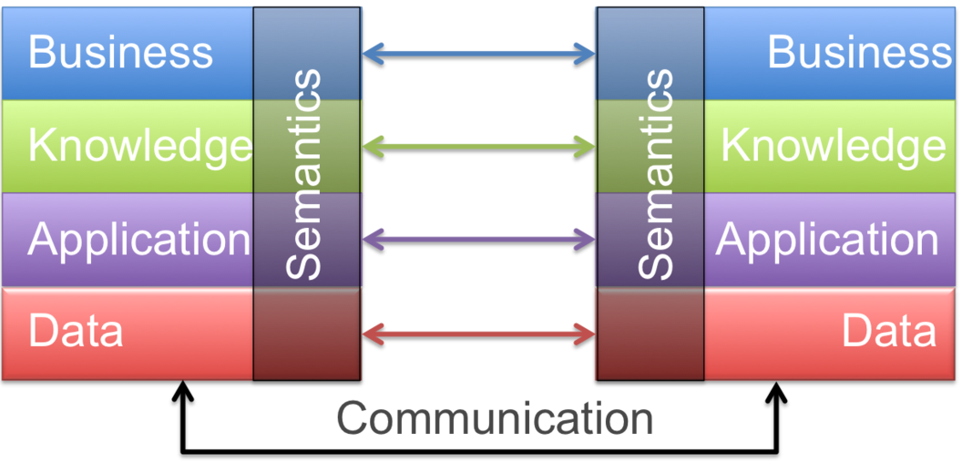
Aim for Interop, not Integration...
By Wkinterop - Powerpoint -> PNG, CC BY-SA 3.0, https://en.wikipedia.org/w/index.php?curid=35139609

Slide 63
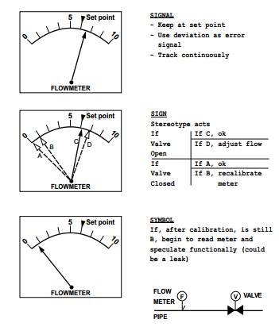
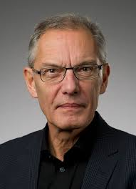
Signal, Sign, and Symbol
Jens Rasmussen

Slide 64
Signal, Sign, and Symbol
Signal: Protocol
Sign: Format
Symbol: Vocabulary

Slide 65
Signal, Sign, and Symbol
Signal: Protocol HTTP, CoAP, etc.
Sign: Format HTML, HAL, etc.
Symbol: Vocabulary ALPS, DCAP, etc.

Slide 66
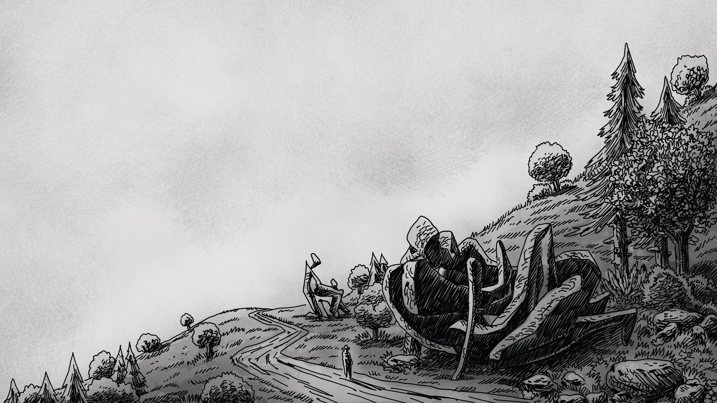
Valley of the Metamorphs

Slide 67
Three Rules for Not Breaking Things...
You can't take things away
You can't change the meaning of things
All new things must be optional

Slide 68
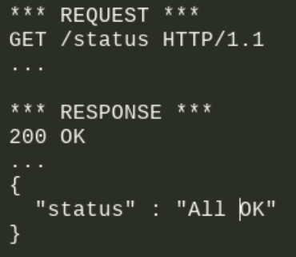
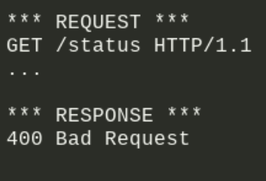
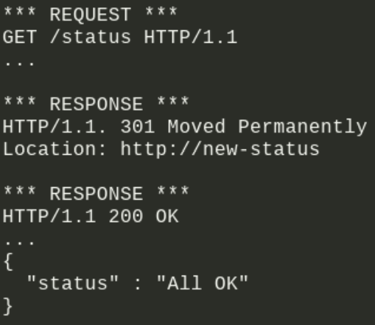
You can't take things away...

Slide 69
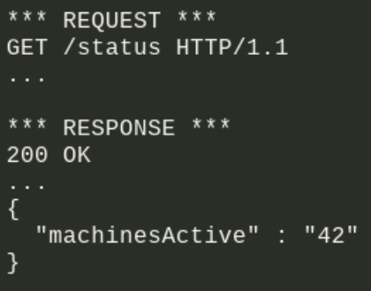
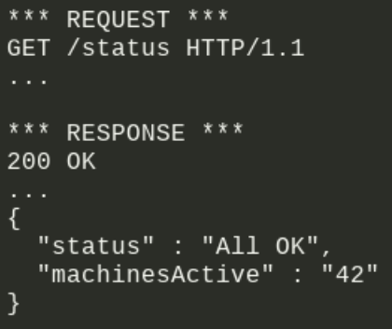
You can't change the meaning of things...

Slide 70
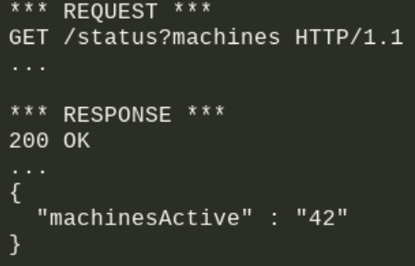
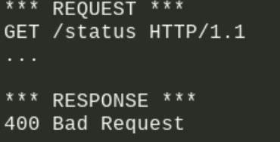
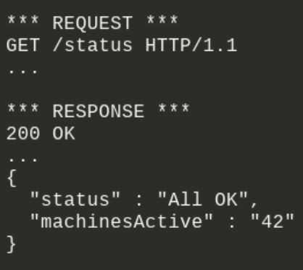
All new things MUST be optional...

Slide 71
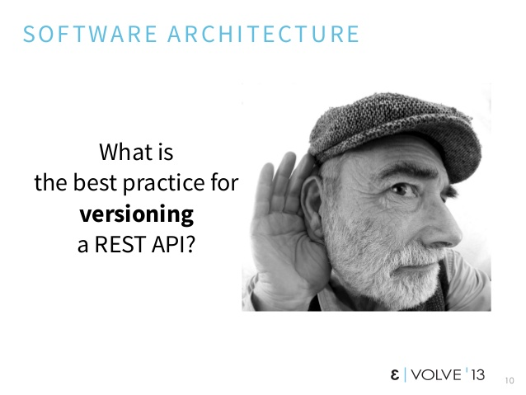
Roy Fielding, 2013

Slide 72
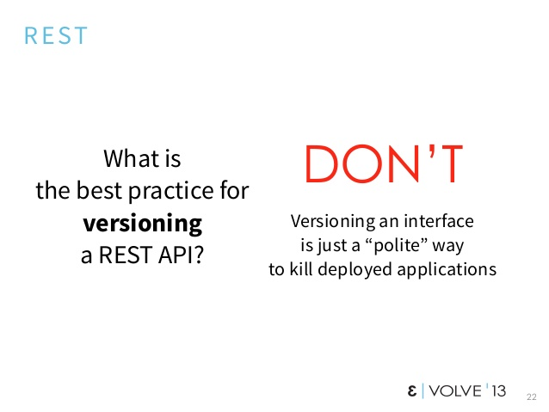
Roy Fielding, 2013

Slide 73
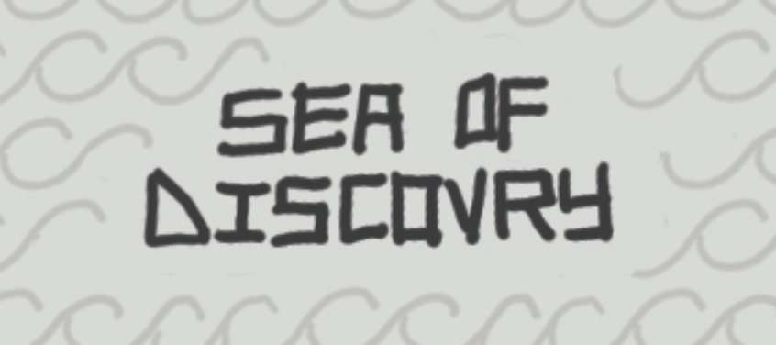

Slide 74
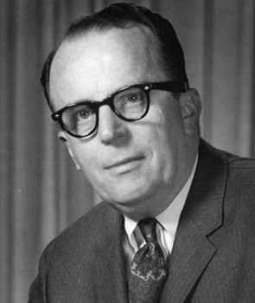
Service Discovery
"How do you get communication started among totally uncorrelated 'sapient' beings?" -- J. C. R. Licklider, 1963

Slide 75

Service Discovery

Slide 76
Service Discovery

Slide 77
Service Discovery

Slide 78

Service Discovery

Slide 79

Service Discovery

Slide 80
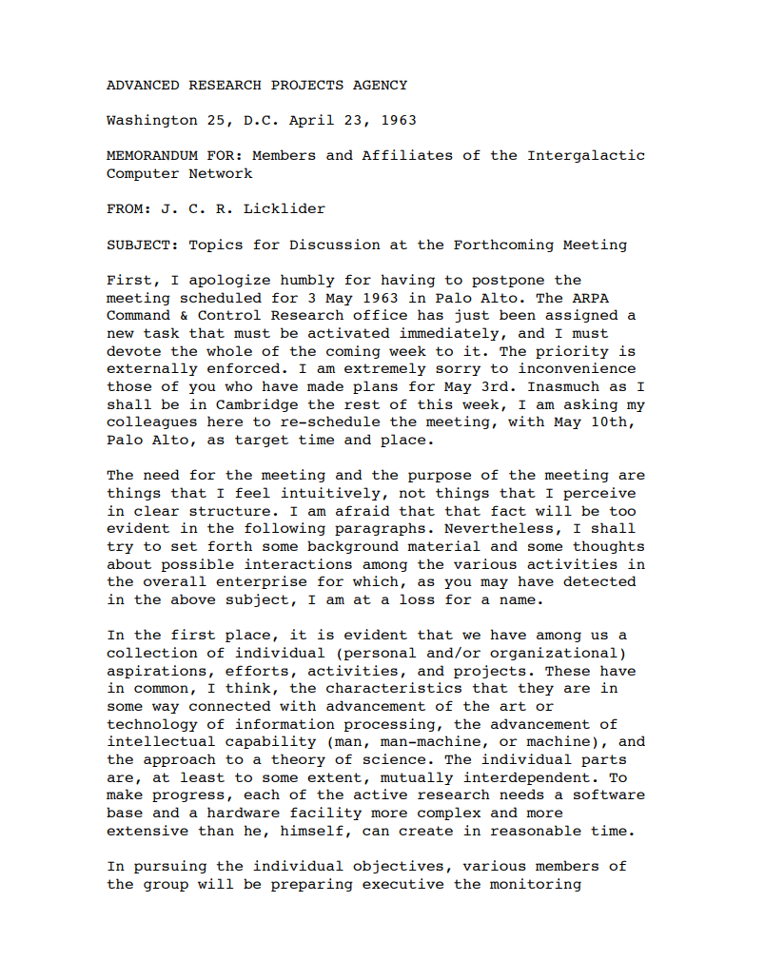
Licklider Memo (1963)

Slide 81
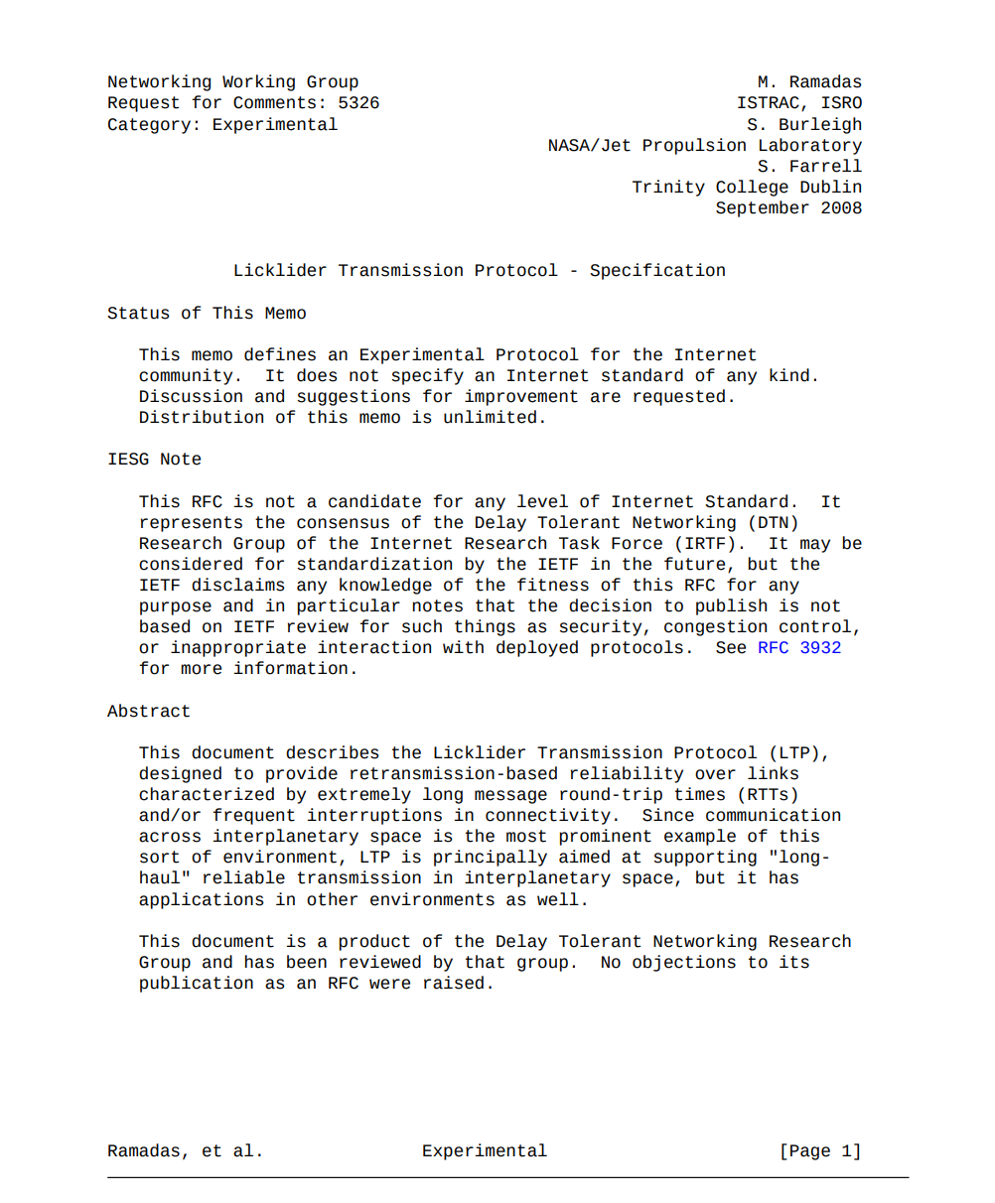
Licklider Memo (1963) Licklider Protocol (2008)

Slide 82
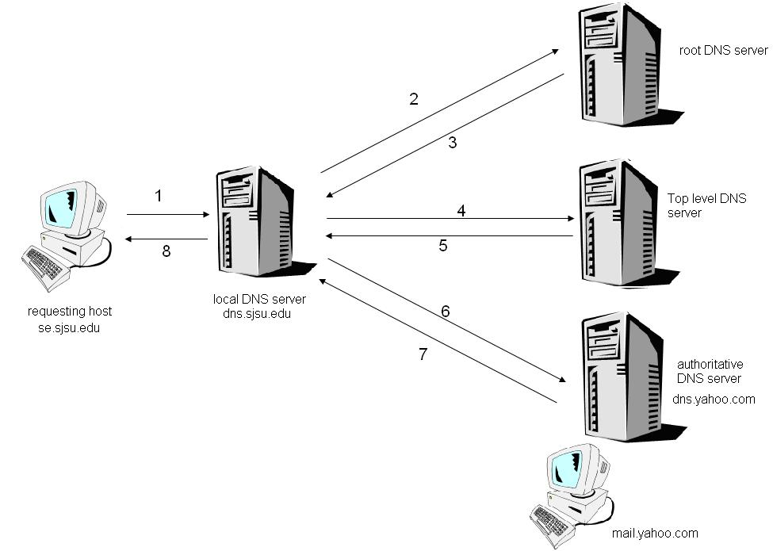
DNS for discovering machines

Slide 83
But we need to discover services...

Slide 84
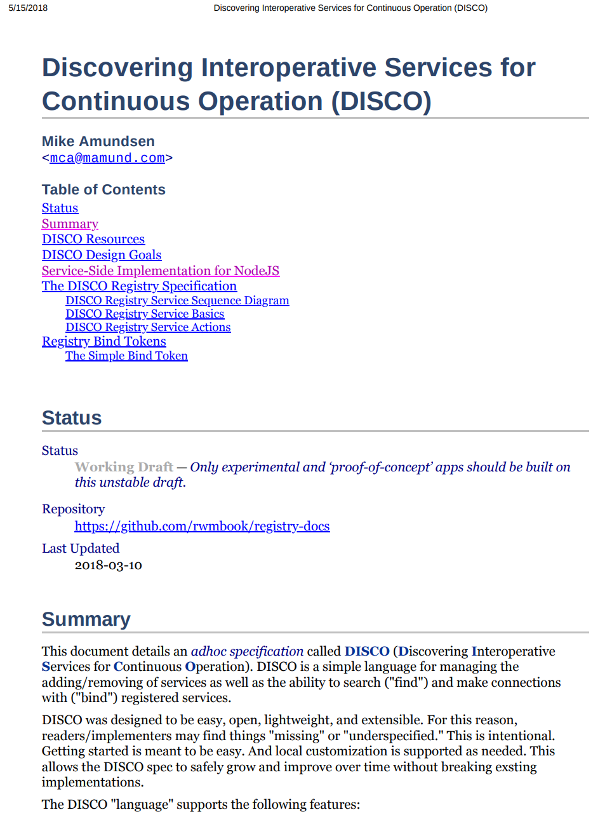
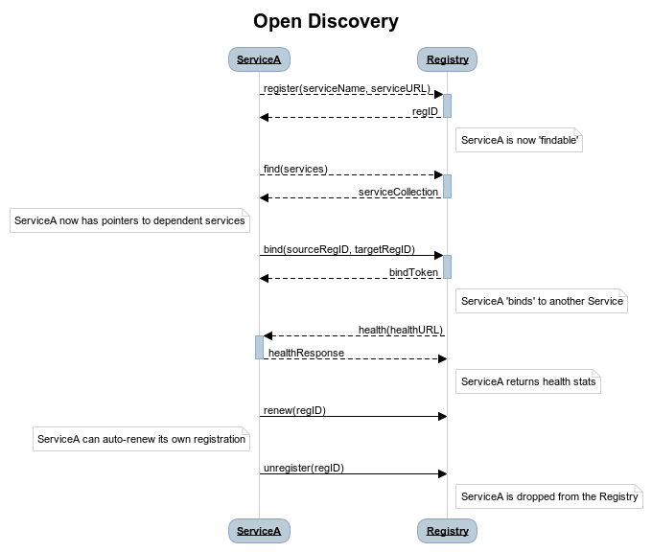
Discovering Interoperative Services… (DISCO)
open-disco.org

Slide 85
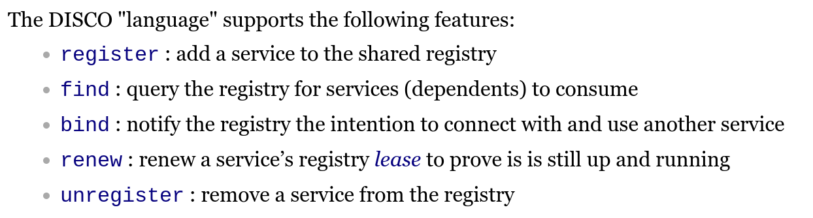
Discovering Interoperative Services… (DISCO)

Slide 86
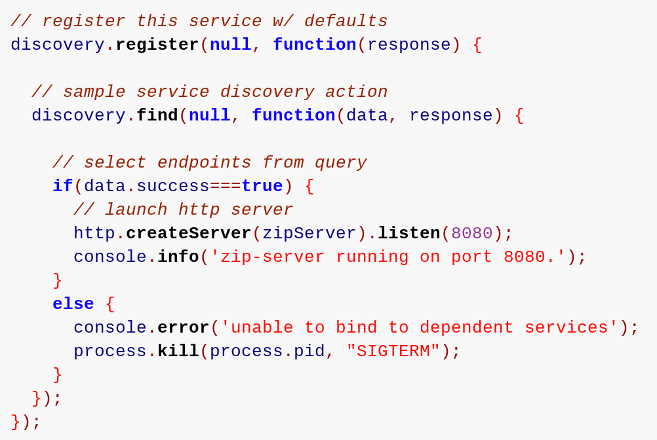
Discovering Interoperative Services… (DISCO)

Slide 87
Service Discovery

Slide 88
Service Discovery

Slide 89
So...

Slide 90
We need better maps...

Slide 91
So that we can program the network...

Slide 92
Which means applying patterns to our code..,
Fail-Fast
Timeout
Circuit Breaker
Steady State
Handshaking
Bulkhead

Slide 93
And that means understanding the role of semantics...

Slide 94
And the importance of change over time...

Slide 95
And the power of service-level discovery...

Slide 96
That's a lot!

Slide 97
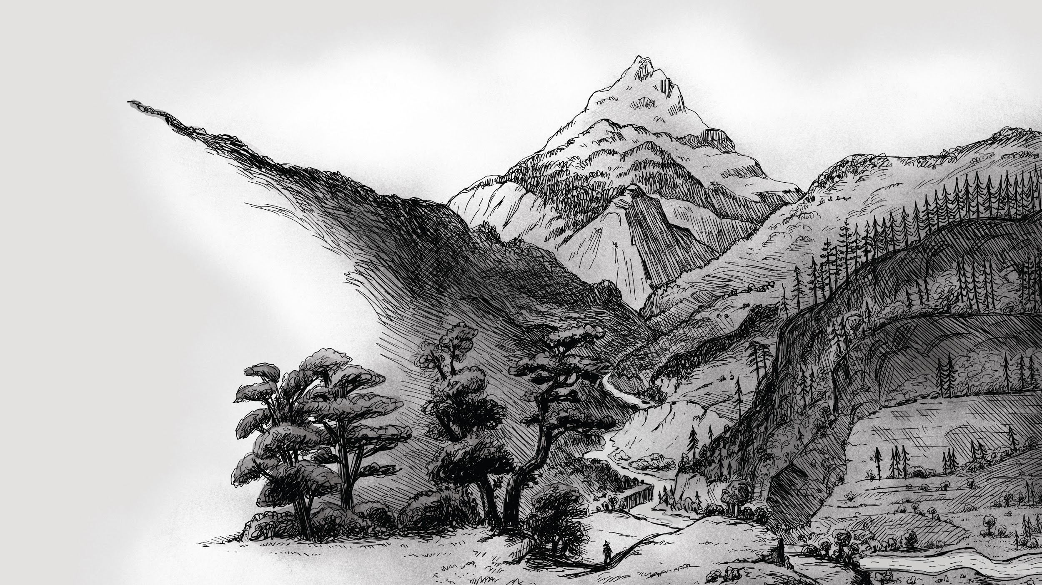
"The journey of a thousand miles begins with one step." -- Lao Tzu

Slide 99
Discovering RESTful Web Microservices
http://g.mamund.com/2019-02-sacon
Mike Amundsen @mamund API Academy

